Slide 1
Affordable Power Supply
sdmay21-47
Notes:
Ben

Slide 2
Acknowledgements
Our project advisor/client is Prof. Gary Tuttle. We would like to take a moment to thank Prof. Tuttle for all the help this year with our project.
Notes:
Ben

Slide 3
Problem and Project Statement
With Covid-19 limiting lab availability to students, it is difficult for electrical engineering students to work with any hardware because they do not have power supplies to test their circuits. It would be beneficial for students studying electrical engineering to have access to a power supply at home during this pandemic.
The solution for this problem is to design an affordable power supply that any electrical engineering student can easily build and operate from home. This will allow students to perform any hardware labs for their electrical engineering courses without requiring access to an on-campus lab.
Notes:
Mary

Slide 4
Requirements
Input: 120 Vrms AC wall power
Four Functional Outputs:
DC 1: 2V to 25V adjustable. 1A max current. Binding post connection.
DC 2: -2V to -25V adjustable. 1A max current. Binding post connection.
DC 3: 1V to 10V adjustable. 1A max current. Binding post connection.
DC 4: 5V fixed. 2A max current. USB type A connection.
Size of the unit: 7”x 4”x 2”
Maximum Cost: $100 per unit
Microcontroller (Optional)
LCD (Optional)
Notes:
Mary

Slide 5
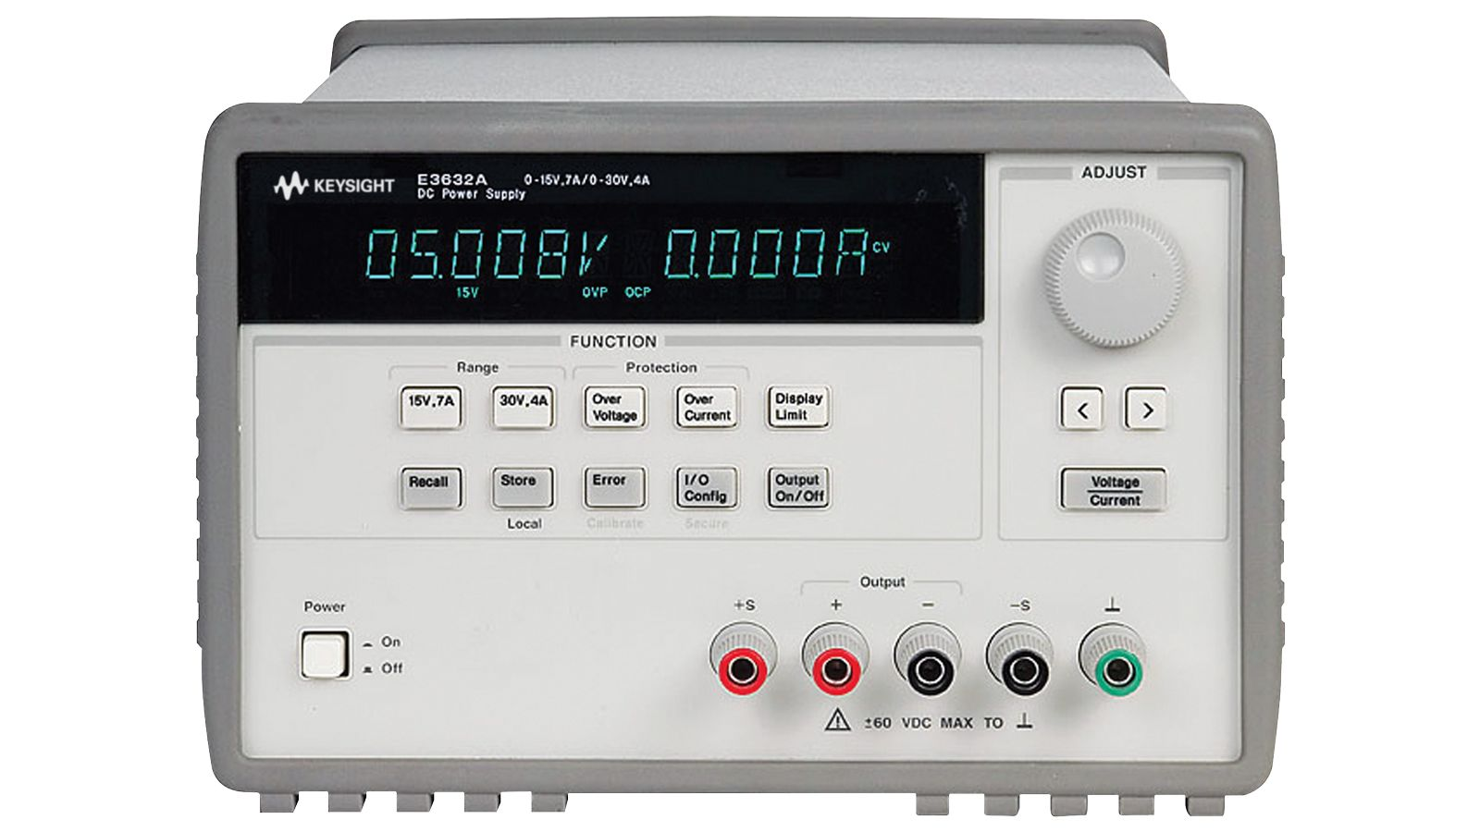
Intended Users and Uses
Students taking circuit based classes that are virtual or would like to test circuits at home
EE 201
EE 230
Notes:
Krishan

Slide 6
Development Standards
IEEE 1100 - 2005: Recommended Practice for Powering and Grounding Electronic Equipment
This standard provides guidance on how to enhance performance and keep safety protocols. It also includes how to protect the devices and resolve any problems with select instruments.
IEEE 1332 - 2012: Standard Reliability Program for the Development and Production of Electronic Products
This standard provides guidance for communication between designer and consumer on best practices for reliability and consistency of electronic products.
Notes:
Krishan

Slide 7
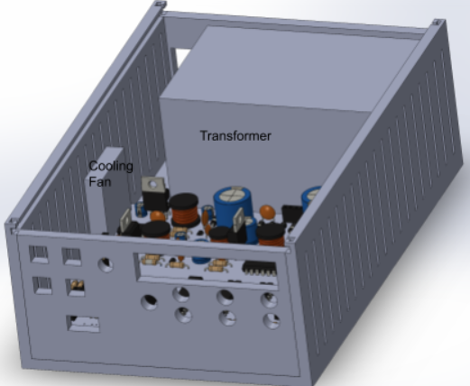
Design Overview
Multiple voltage regulators
I/O
Rotary Encoder
2x16 LCD display
Four buttons
Four outputs (3 binding posts + USB-A)
Universal ground (Binding post)
Microcontroller
Notes:
Michael

Slide 8
Safety
Limited output currents
Limit exposed wiring
Safety guide in the user manual
Rubber feet to keep device from sliding
Fan for cooling
Notes:
Ben

Slide 9
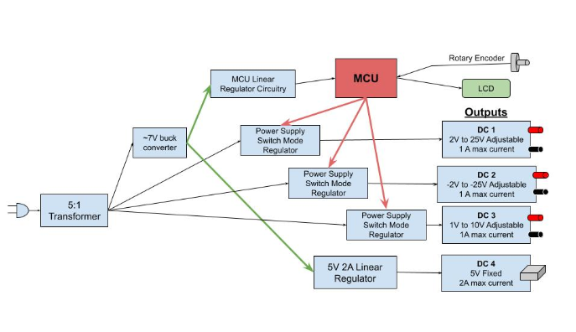
Design Block Diagram
Notes:
Michael

Slide 10
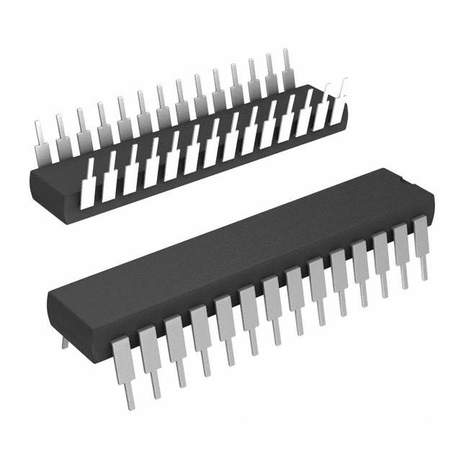
Part Selection
Microcontroller (PIC18F26Q10)
Adequate amount of I/O pins for our needs
Internal oscillator
Team member had experience with this microcontroller
2 to 25 VDC switching regulator (LM2595TADJG)
Needed ~30V input with 2-25V at 1A output
Many affordable options, through-hole selected
-2 to -25 VDC switching regulator (LT1931ES5#TRPBF)
Difficult to find a part meeting specs
Forced to choose surface mount part with 16V max input
1 to 10 VDC switching regulator (LMR14010ADDCR)
Needed ~30V input with 1-10V at 1A output
Difficult to find requirements, forced to choose surface mount part
Notes:
Ben

Slide 11
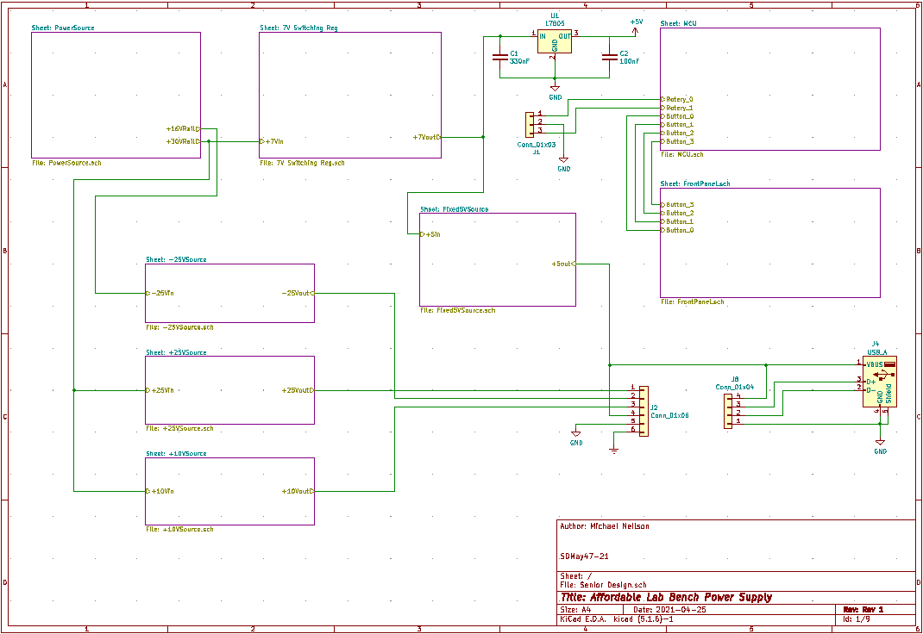
Schematic (High level)
Notes:
Michael

Slide 12
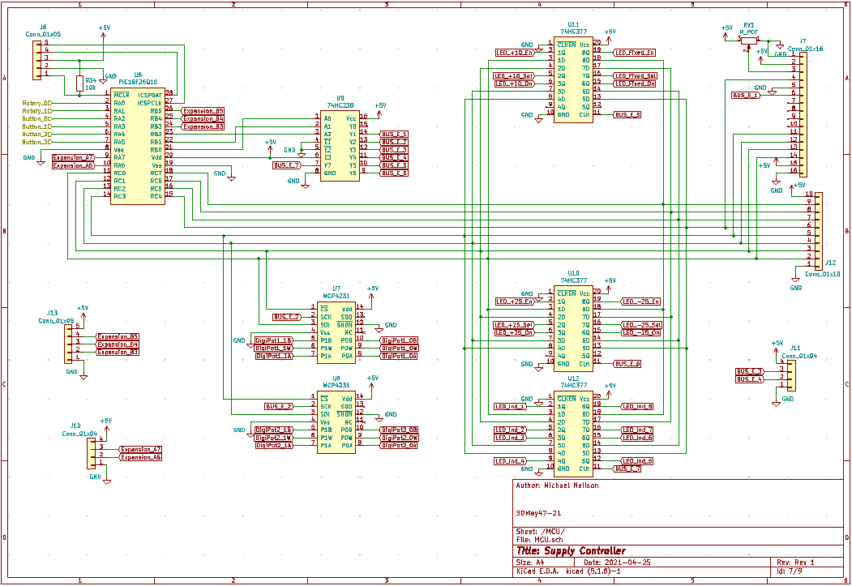
Schematic (MCU)
Notes:
Michael

Slide 13
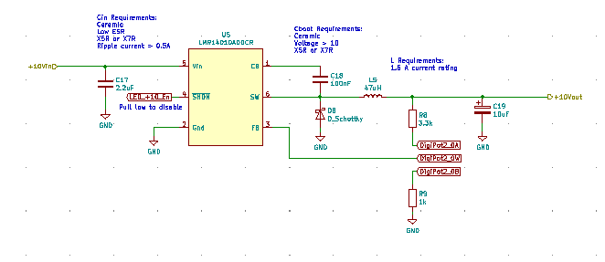
Schematic (Regulators)
-2V to -25V
1V to 10V
2V to 25V
Notes:
Michael

Slide 14
PCB Design
4.6 x 4.5in (118 x 115mm)
Board Stack-up
Top- Signal
In1- Ground
In2- Power
Bottom- Signal
Notes:
Michael

Slide 15
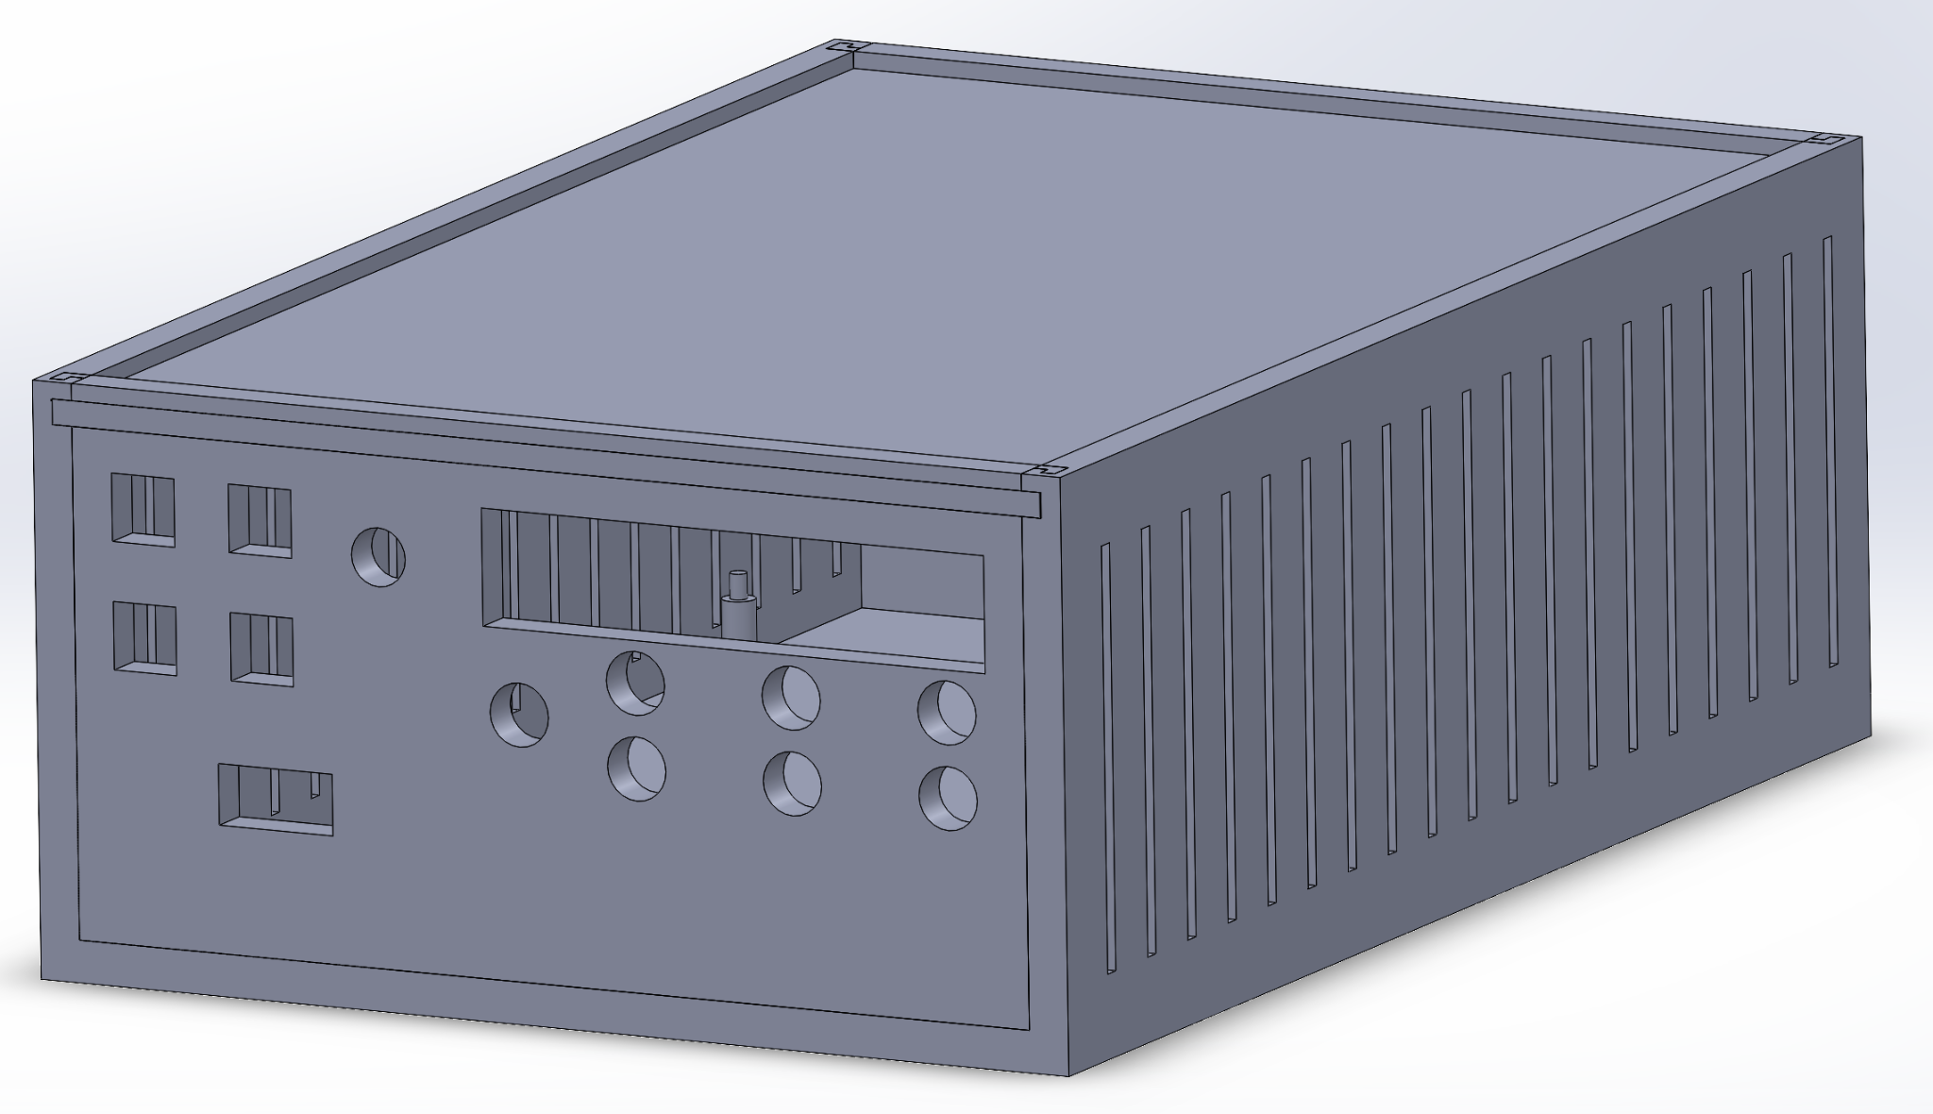
Enclosure
Five parts that slide together to allow easy access to the inside and to build it.
Chose 3D printing because we could be more specific with the interface, as well as pegs for the PCB to be held by.
Notes:
Chance

Slide 16
Unit Testing
Tested each individual component separately to verify each component's functionality
Voltage regulator ICs
Built the designed schematic on a breadboard
Tested it using a lab supply as input and a multimeter to read the voltage output.
During the initial run of testing, we used standard analog potentiometers in place of the digital potentiometers in the design.
Prefer to use the digital potentiometers during interface testing as well.
Notes:
Chance

Slide 17
Interface Testing
LCD, rotary encoder, and push buttons tested with the working voltage regulator circuits
Confirmed push buttons select voltage output to change
Confirmed rotary encoder changes voltage level
Confirmed LCD displays relevant information
Notes:
Chance

Slide 18
Acceptance Testing
Our acceptance testing for the power supply is done by testing each output voltage and current levels with a multimeter to ensure the voltage ranges are correct.
Tested the system with the microcontroller and digital potentiometers.
PCB is needed to complete most the testing, and we encountered an issue with our PCB order and have not received the PCB. The results that we have received thus far have been very good and expect nothing less from the PCB design.
Notes:
Chance

Slide 19
Demonstration (1 to 10 VDC Output)
Notes:
Adam

Slide 20
Demonstration (-2 to -25 VDC Output)
PCB was not going to arrive in time for testing
Decided to demo individual outputs in its absence
Negative output worked during initial unit testing, but did not work when we recorded demos this week
Did not have enough lab time to thoroughly troubleshoot the issue as plan was just to record demos
Confident that output would work on PCB
Notes:
Adam

Slide 21
Demonstration (2 to 25 VDC Output)
Notes:
Adam

Slide 22
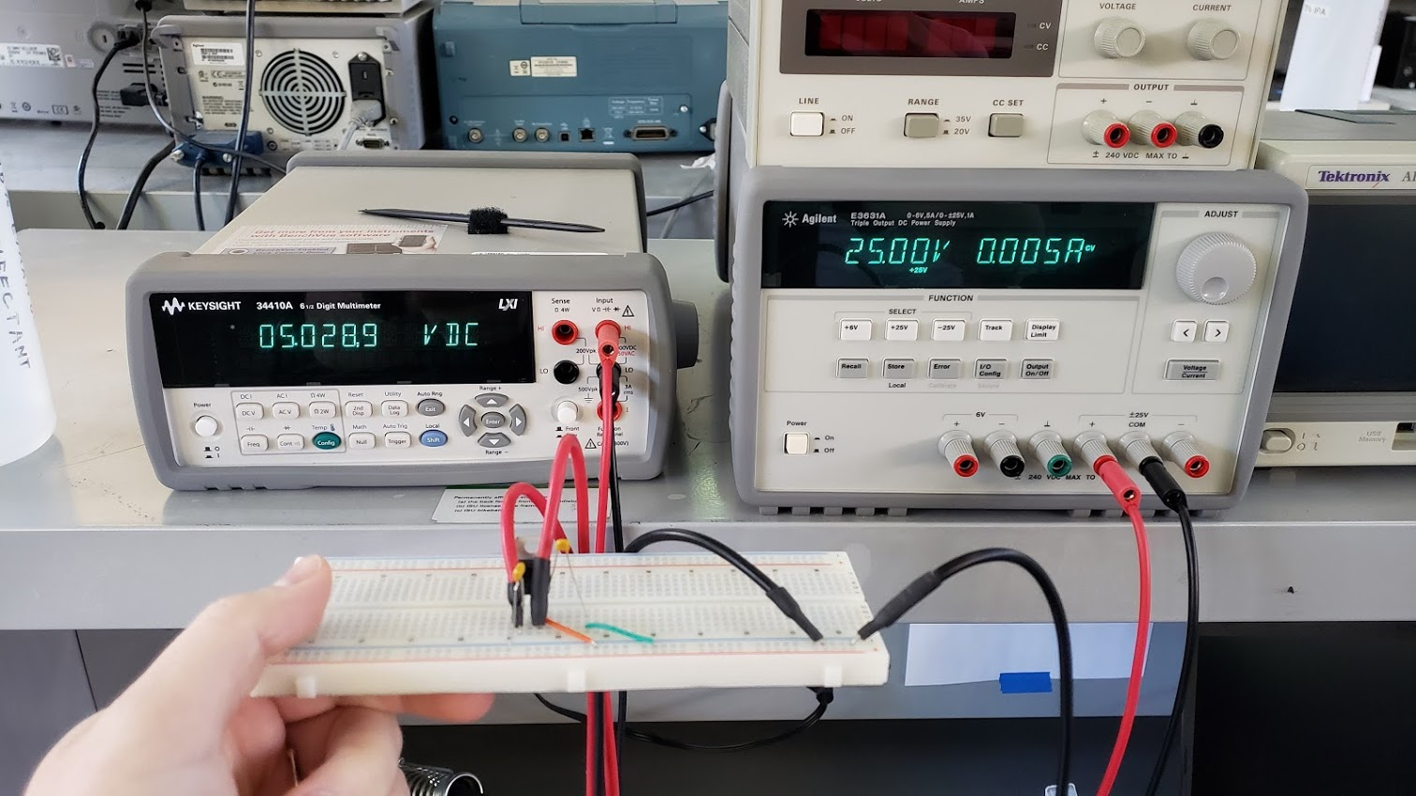
Demonstration (5VDC Fixed Output)
Notes:
Adam

Slide 23
Demonstration (Rotary Encoder)
Notes:
Adam

Slide 24
Conclusion
Final approximate price per unit including PCB and casing: $95
Below price requirement of $100
Significantly cheaper than market quad-output power supplies
Notes:
Ben

Slide 25
Group Members and Roles
Ben Almquist- Test Engineer
Mary Le- Test Engineer
Michael Neilson- Technical Expert
Adam Simodynes- Team Leader
Krishan Sritharan- Report Manager
Chance Webster- Meeting Facilitator
Notes:
Ben

